Slide 1

Log Anomaly Detection
Scaling AI-Driven Anomaly Detection with Logs
Notes:
Today, we’ll be covering Log Anomaly Detection and how logs are critical to scaling AI-driven anomaly detection and a unified observability strategy.

Slide 2
Agenda
Log Anomaly Detection
The Power of Logs
Anomaly Detection Fundamentals
Detecting Anomalies Directly from Logs
Extracting Metrics from Logs for Anomaly Detection
Scalability and Best Practices

Slide 3
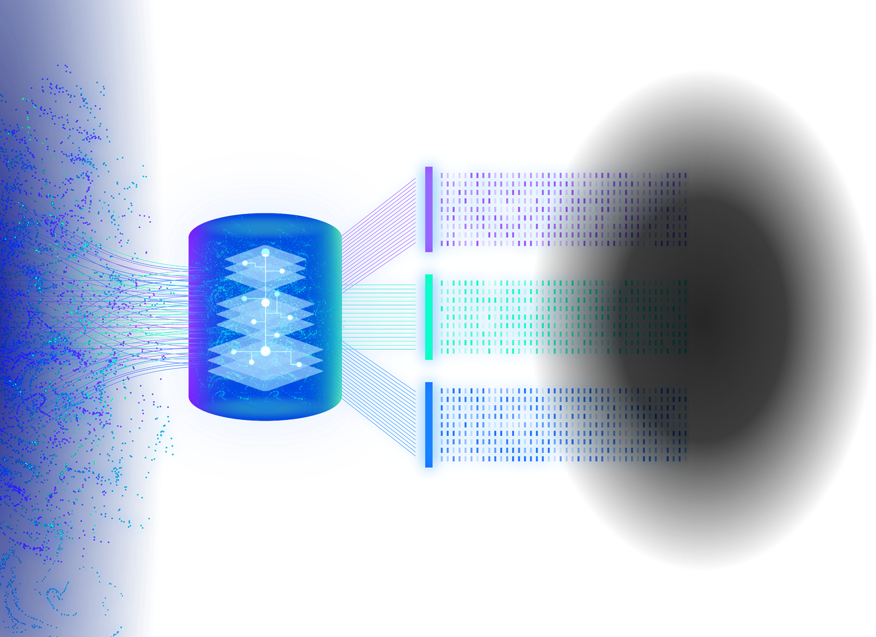
The Power of Logs
Insights through Log Data
Log data provides profound visibility into application and system behavior, helping teams understand performance and issues quickly.
Scalable Schema-Free Management
Grail introduces index-free and schema-free log management, allowing instant scalability and adaptability for diverse data sources.
Efficient Data Querying
DQL empowers users to efficiently query log data, enhancing troubleshooting, monitoring, and proactive analysis workflows.
Notes:
Logs offer real-time visibility that helps teams quickly identify performance bottlenecks and troubleshoot issues. The introduction of Grail's index-free and schema-less log management means that organizations can scale their log data effortlessly without being constrained by rigid schemas. This flexibility supports diverse data sources and evolving environments. Additionally, the DQL (Dynatrace Query Language) feature enables efficient querying of log data, streamlining monitoring and proactive analysis. Together, these capabilities empower teams to maintain system health and optimize performance with greater agility and precision.
With Dynatrace, we aren’t just sending alerts off of log data; we’re leveraging AI analysis and decision making to drive automation that improves reliability and secures business critical systems.

Slide 4
Anomaly Detection Fundamentals
Automatic Baselining
Uses multidimensional and seasonal data to create adaptive baselines, responding to changing usage patterns and trends.
Static Thresholds
Relies on fixed thresholds to identify when observed data points exceed normal operating ranges and trigger alerts.
Correlating Events into Problems
Davis AI groups related anomalies, providing root-cause analysis to speed up issue resolution and reduce system downtime.
Notes:
Dynatrace, powered by the Davis AI, analyzes metrics, traces, and logs in real-time to uncover anomalies without having to run manual queries. Every log ingested into the Grail data lakehouse is available for Davis AI to crunch. By running AI-driven analysis on thousands or millions of log lines in seconds, Dynatrace automatically identifies unusual patterns or spikes in log data. This means “needle in a haystack” anomalies (like a rare error message or a sudden surge in log volume) can be detected and flagged as Problems by Davis – even if you didn’t know to look for them.
Anomaly detection uses a combination of machine-learning baselining and pattern recognition on log content.
Davis will then automatically correlate anomalies and use its deterministic capabilities to pinpoint the root cause.

Slide 5
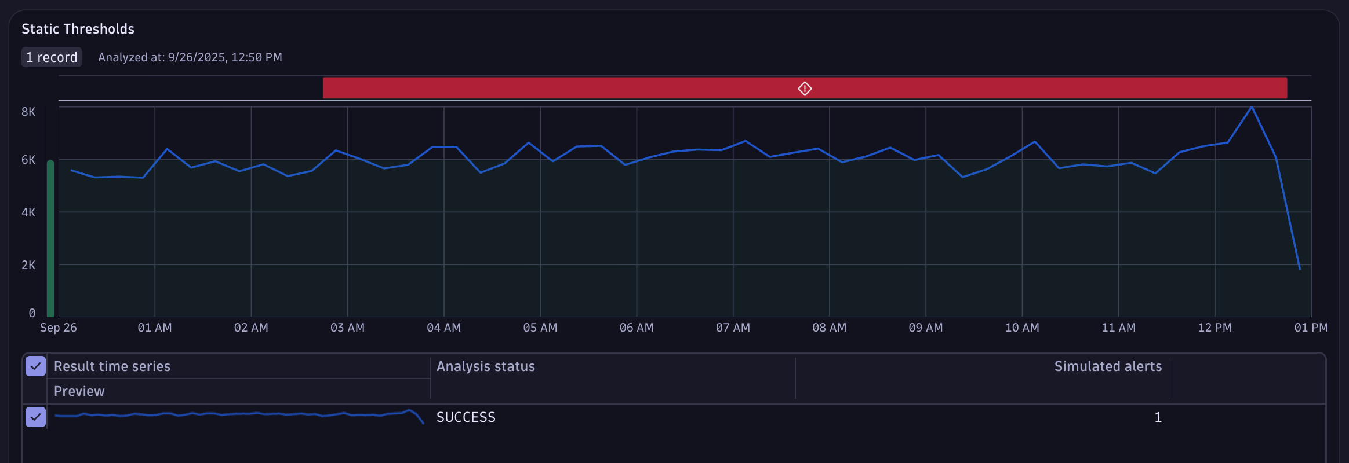
Static Thresholds
A static threshold represents a hard limit that a metric should not violate. Because static thresholds don't change over time, they are an important monitoring tool for defining critical boundaries of normal operation.
Notes:
Using a static threshold is deal for a non-volatile measurement; When we know the limits of a system, these are ideal identifying them right away.

Slide 6
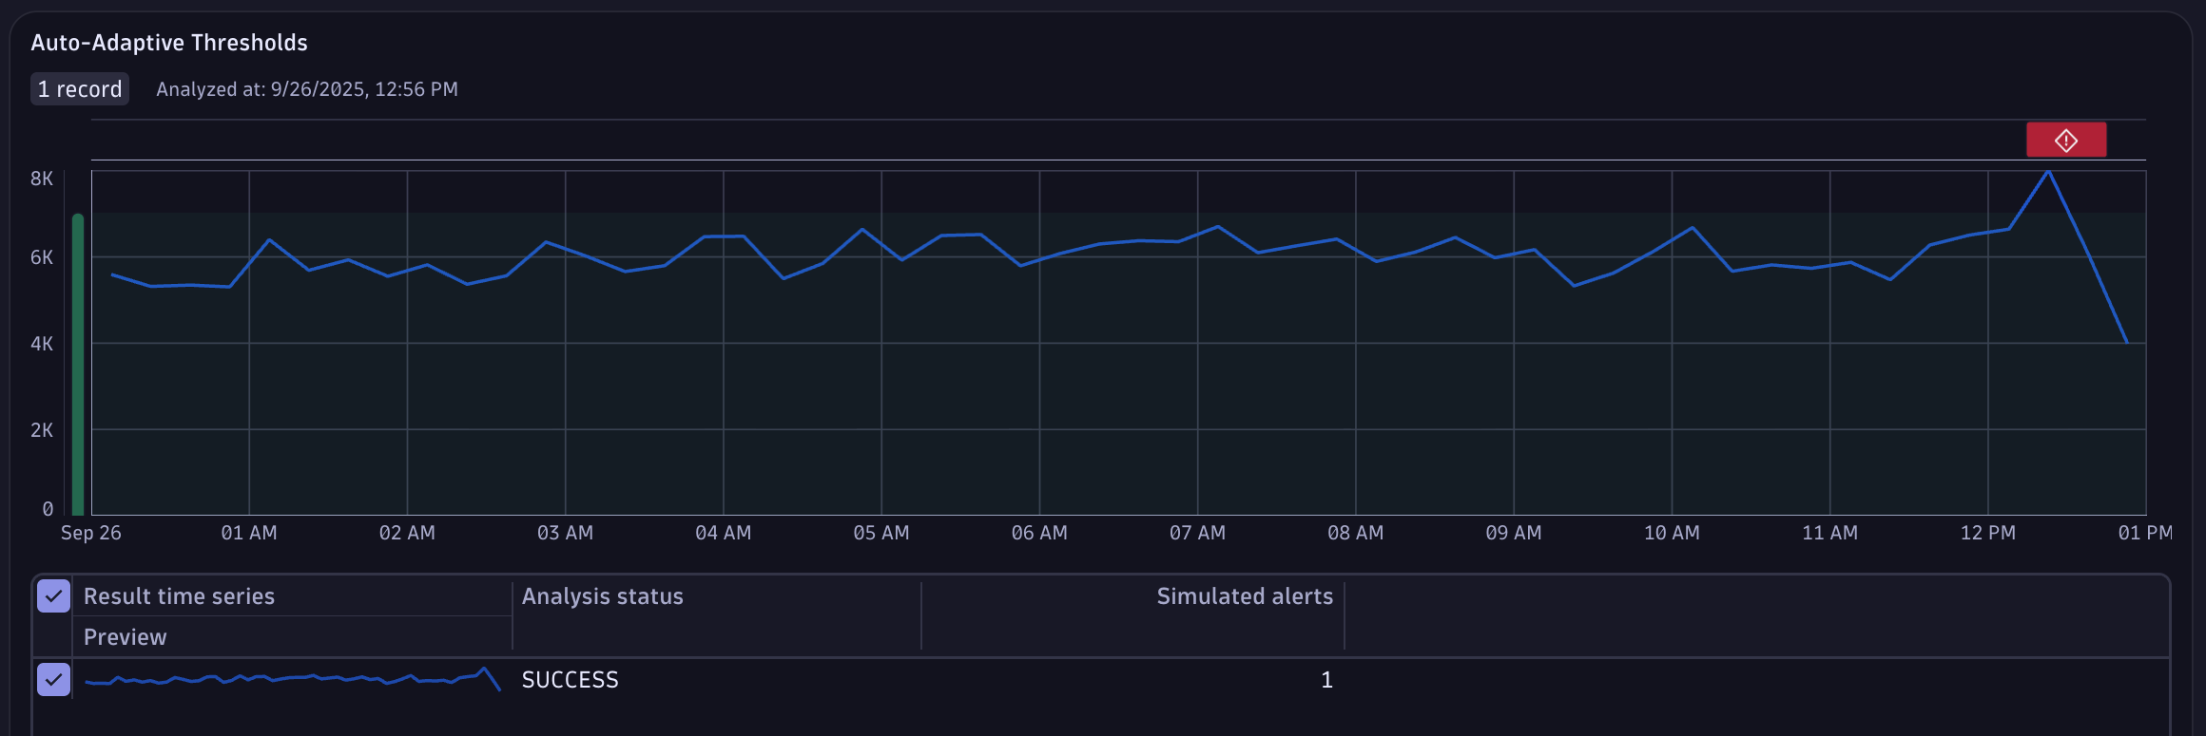
Auto-Adaptive Thresholds
Auto-adaptive thresholds are a dynamic approach to baselining where the reference value for detecting anomalies changes over time. The main advantage over a static threshold is that the reference value dynamically adapts over time, and you don't have to know the threshold upfront.
Notes:
However, we may not always know the limits of a system. Also, those limits could change drastrically over time. Manually changing the threshold on a frequent basis simply isn’t feasible. Instead, we can enable the Davis AI to learn what is normal, continuously calculating that baseline of normality. At the same time, Davis will recalculate the threshold of signal fluctuation; allowing it to identify anomalies based on unexpected and abnormal measurements that it observes.

Slide 7
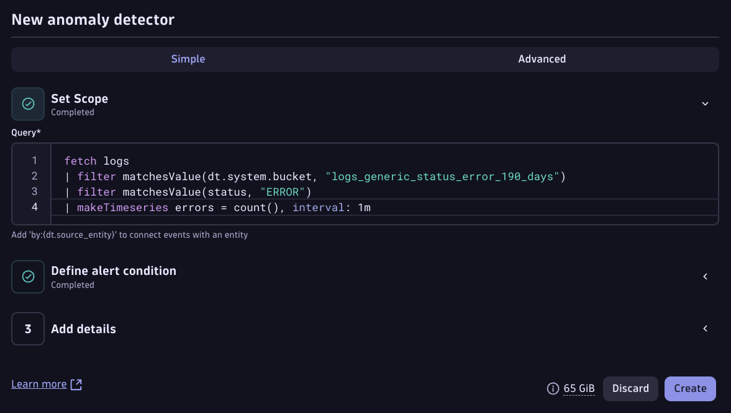
Detecting Anomalies Directly from Logs
Use Davis Anomaly Detection app to turn DQL queries into automated AI analysis.
Convert raw log data into timeseries for Davis AI to detect anomalies using static thresholds, auto-adaptive baselines, or seasonal baselines.
Notes:
The Dynatrace Query Language (DQL) allows on-demand aggregation of log data into time series for anomaly detection. For example, you can filter logs and use the command makeTimeseries to generate error counts per minute – Davis can then apply anomaly detection (auto-adaptive or static) on that series. DQL is powerful for defining exactly which log signal to monitor.
This is configured using the Davis Anomaly Detection app, which provides tremendous flexibility to meet your needs.

Slide 8

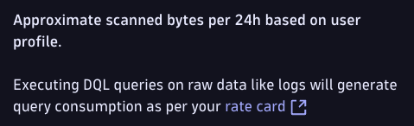
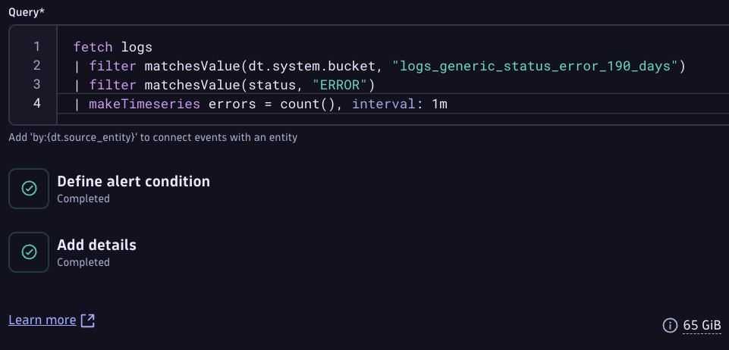
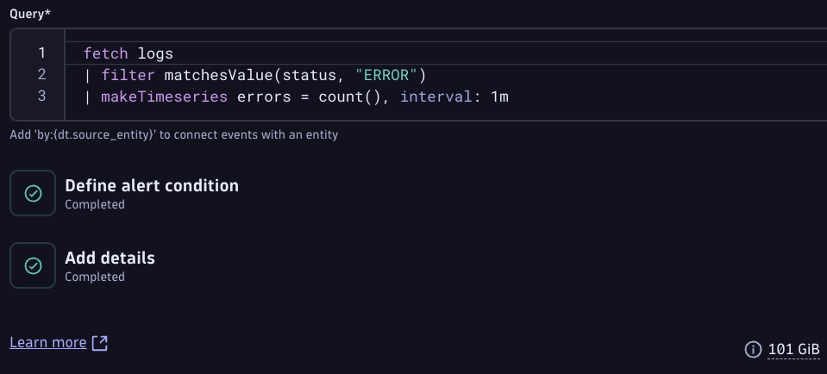

Detecting Anomalies Directly from Logs
Optimize anomaly detection queries to limit scanned data.
Notes:
When an anomaly detector is configured, you’re allowing Davis to query, analyze, forecast, and react on your behalf. When query log data directly, it’s important to consider the impact of those queries.
By refining these queries, we can reduce the amount of data scanned, which improves performance and speeds up the detection process. This approach helps in identifying unusual patterns or issues directly from logs without overwhelming system resources. It’s a key strategy for maintaining system reliability and quickly responding to potential problems.
Notice the difference in scanned bytes as a result of query optimization. In this example, we’re filtering on a specific bucket of log data.

Slide 9
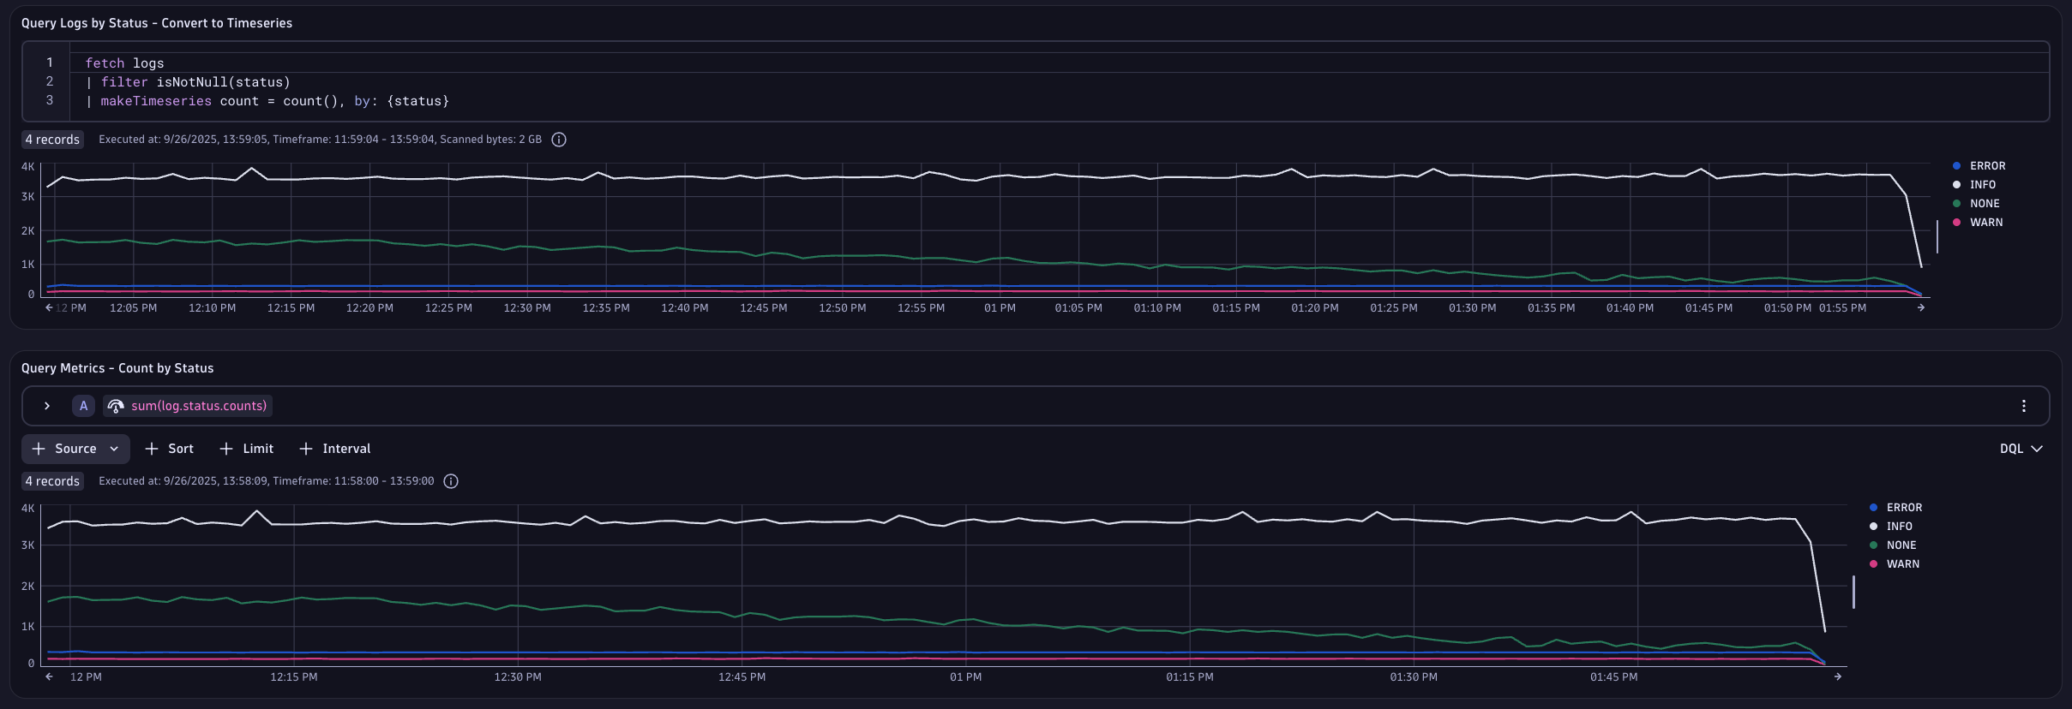
Extracting Metrics from Logs for Anomaly Detection
Dynatrace can convert raw log data into numeric metrics (count or value).
Using log-derived metrics for anomaly detection is generally more scalable and noise-resistant.
Notes:
There’s an even better way we can optimize performance and mitigate costs.
Dynatrace can turn log data into custom metrics on the fly. For example, count the number of errors per minute, or measure the size of messages in a queue from log content. This happens during log ingestion via Dynatrace Metrics Extraction rules within OpenPipeline. The result is a time-series metric (for example, log.status.counts) that gets stored like any other metric.
Once log data is a metric, Davis AI can baseline it over time and detect anomalies with its full arsenal of detectors. It will learn the normal pattern (including daily cycles, workload changes) and raise an anomaly if the metric deviates significantly. Essentially, we apply Dynatrace’s proven metric anomaly detection to data that originated in logs.

Slide 10
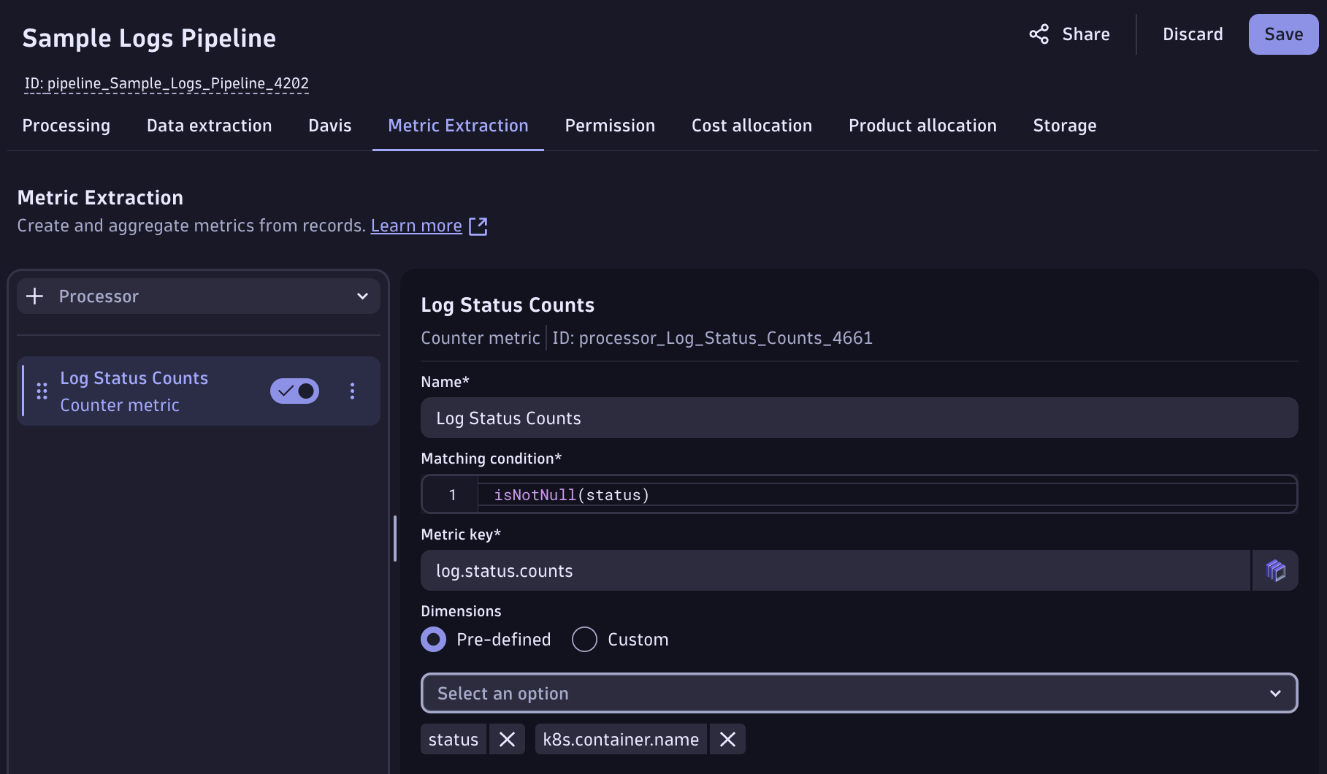
Extracting Metrics from Logs for Anomaly Detection
Use OpenPipeline to extract metric data points during log ingest
Include dimensions for metric splitting AND topology context for unified observability analysis
Notes:
When we set up our pipeline, we can add a metric extraction processor. Any logs that match our conditions (think of a filter command in your query) will then contribute data points to that metric. By incorporating dimensions for metric splitting, we can analyze data more granularly, enabling precise anomaly detection. Additionally, including topology context enriches the data, allowing for unified observability across systems. This approach helps in correlating metrics with their operational environment, improving the accuracy and relevance of anomaly detection efforts.

Slide 11
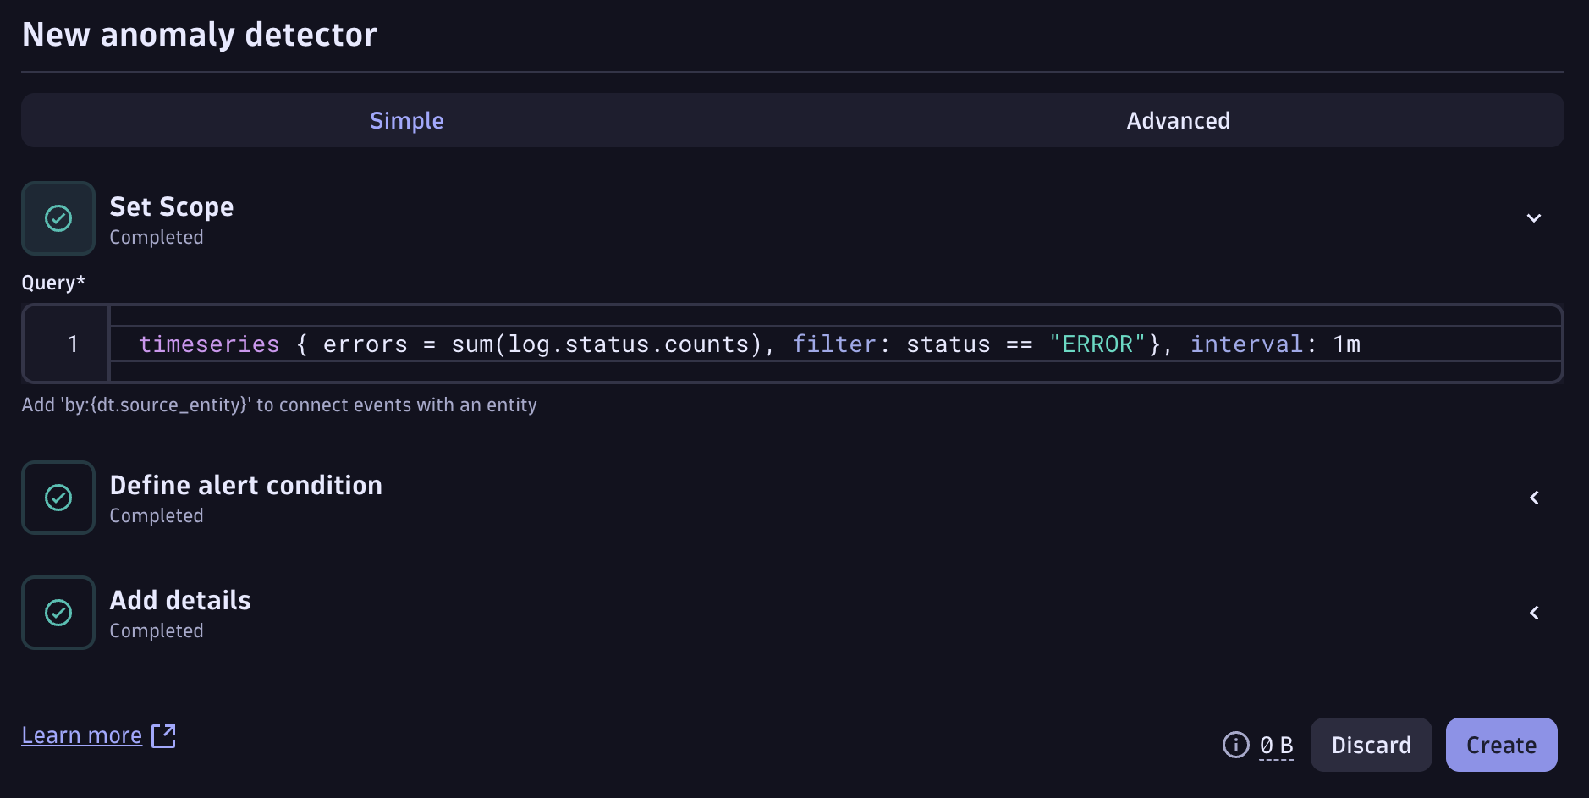

Extracting Metrics from Logs for Anomaly Detection
Create a Davis anomaly detector using DQL to query timeseries (metric) data
Accomplish the same result, with zero query consumption and better performance
Notes:
Now we can use our new metric, generated from ingested log data, to let Davis AI detect anomalies in observed data points. The key advantage here is achieving the same detection results with zero query consumption, meaning it operates without incurring additional query costs, while also delivering improved performance. This approach optimizes resource usage and speeds up anomaly detection, making it highly effective for monitoring systems where timely identification of irregularities is critical.

Slide 12
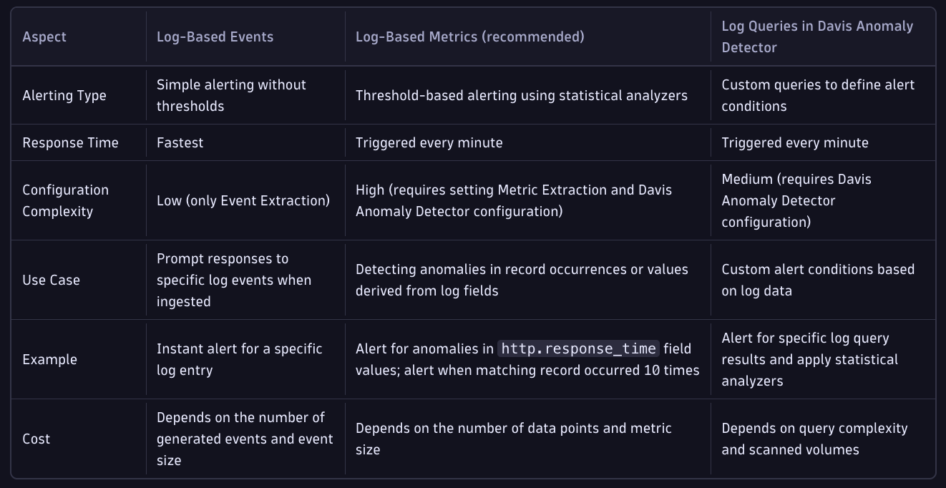
Comparison of Alerting Methods
Notes:
Davis anomaly detection from log data is powerful, flexible, and built for enterprise scale. With different approaches (or alerting methods) available, choose the best one for each use case to accomplish needs while maintaining cost and performance optimizations.

Slide 13
Scalability and Best Practices
Target Specific Signals:
Scope your log anomaly queries to optimize them
Use filters (by bucket, service, log level, topology) so Davis isn’t scanning unrelated logs
Use Log Alerts for One-off Events:
Leverage OpenPipeline to detect anomalies from a single log record and extract a Davis event
Detect it immediately when it happens instead of continuously querying aggregate data
This is ideal for catching known critical errors immediately, with less overhead.
Watch the Frequency:
Davis anomaly detectors query every 1 minute
Avoid querying large data timeframes (last 24 hours, last 7 days, etc)
Leverage Workflow automations for lower frequency and longer timeframes
Leverage Buckets and Retention:
Store logs needed for anomaly detection in separate buckets and reduce scan volume
Optimizes cost and performance
Notes:
Target Specific Signals: Scope your log anomaly queries to a focused subset of data. Use filters (by service, log level, text, or bucket) so Davis isn’t scanning unrelated logs. For example, filter to just the payment-service logs or a specific Kubernetes namespace’s bucket if you only care about that context. This keeps analysis efficient even in large environments.
Use Log Alerts for One-off Events: If you simply need to know when a particular log appears, you don’t always need a full anomaly detector. Dynatrace allows straightforward log event alerts that trigger when a filtered condition is met. For instance, you can set an alert “whenever an Nginx Connection refused error is logged” using a direct log query filter, without any time-series or baselining. This is ideal for catching known critical errors immediately, with less overhead.
Watch the Frequency: Remember that anomaly detection on logs works by periodically querying Grail. Running a DQL-based analysis every minute on a huge log dataset can incur cost and latency. For high-volume logs, consider scheduling analysis less frequently (if real-time isn’t needed) or narrowing the time window. Dynatrace Workflows can also be used to run anomaly detection on a schedule (e.g., every hour or nightly) for log patterns that don’t need instant alerts.
Leverage Buckets and Retention: In large environments, store long-term or high-volume logs in dedicated buckets and use those in your queries. This not only improves query performance but also lets you apply appropriate retention (for example, keep debug logs shorter, audit logs longer). An anomaly query pointed at a 200GB/day bucket will run more efficiently than one scanning a multi-TB “everything” bucket

Slide 14
Scalability and Best Practices
Limit Metric Dimensions:
Avoid high-cardinality dimensions
Focus on critical dimensions that can isolate fault domain
Limits are built-in to protect your observability
Use Entity Linking:
Include an entity reference as a dimension
Links metric to entity and topology
Davis AI correlates anomaly with other events and aids in root cause analysis
Optimize Cost and Retention:
Extract a metric for anomaly detection (and visualization) from logs with OpenPipeline
Store the log for a shorter duration or not at all
Significantly reduce storage costs and broadly optimize log queries
Notes:
Keep Metric Dimensions Low: Avoid high-cardinality dimensions on log metrics. Each unique dimension value creates a separate time series that Davis must track, so exploding a metric by dozens of tags (host, pod, user, etc. all at once) can lead to thousands of series. Focus on the dimensions that matter for your use case (for example, you might split error count by service name, but not by every single container ID). Dynatrace enforces limits to protect performance (for instance, a maximum number of metric dimensions and metric events per environment).
Use Entity Linking: Whenever possible, include an entity reference (such as dt.source_entity) as a dimension when creating the log metric. This attaches your metric data to the relevant Dynatrace monitored entity (service, host, process, etc.). The benefit is twofold: any anomaly alert will automatically reference that entity (making the problem alert more informative), and Davis AI can correlate the anomaly with other events on the same entity. For example, an anomaly “Error log count spike on Payment Service” can be merged with a “CPU saturation on Payment Service” problem if they occur together, giving a unified view of cause and effect.
Optimize Cost & Retention: One advantage of the log-to-metric approach is you may not need to store all raw logs long-term. If a particular use case only requires anomaly detection and trending (not deep forensic log analysis), you can configure Dynatrace to ingest and immediately discard certain logs after extracting metrics. This is done by sending logs to a pipeline with a metric extraction rule and choosing “Don’t store in a bucket” for those logs. You’ll get the metric data (for alerting and dashboards) without paying the cost of retaining the full log text. This is especially useful at scale – for example, you might not need to keep every heartbeat log, but you do want to be alerted if they stop, so turn them into a metric and drop the rest. Always balance this with compliance and troubleshooting needs: keep the logs you’ll need for root cause analysis, but feel free to trim the fat by using metrics for the parts of log data that are purely quantitative signals.

Slide 15

Thank you

